Slide 1
symposium Challenges of studying families at risk
ERFCON2017
May 17 - 19, 2017
Zagreb, Croatia
FamResPlan team
Faculty of Education and Rehabilitation Sciences
University of Zagreb, Croatia

Slide 2
FamResPlan
Specific characteristics of families at risk: contribution to complex interventions planning (FamResPlan): Project overview
Challenges in defining and connecting constructs in FamResPlan project
Family Resilience Scale: Development and factor structure
Mosaic of ethical issues and lessons learned in the Pilot-study of FamResPlan research project

Slide 3
symposium Challenges of studying families at risk
ERFCON2017
May 17 - 19, 2017
Zagreb, Croatia
Specific characteristics of families at risk: contribution to complex interventions planning (FamResPlan)
project overview
Antonija Žižak, Ivana Jeđud Borić, Anita Jandrić Nišević, Martina Ferić, Irma Kovčo Vukadin
Faculty of Education and Rehabilitation Sciences
University of Zagreb, Croatia

Slide 4
Project
Specific characteristics of families at risk: contribution to complex interventions planning (FamResPlan)
Timeframe
2015-2019
Founded by
Croatian Science Foundation

Slide 5
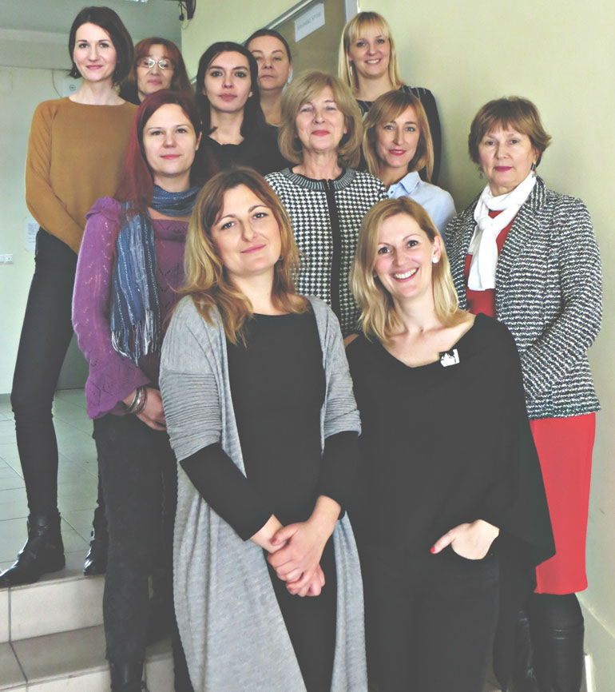
FamResPlan project team
Project leader
Full professor, Antonija Žižak, PhD, Faculty of Education and Rehabilitation Science
Project team, Faculty of Education and Rehabilitation Science
Full professors Nivex Koller-Trbović, PhD Irma Kovčo Vukadin, PhD Associate Professors Martina Ferić, PhD Valentina Kranželić, PhD Anita Jandrić Nišević, PhD | Assistant Professors Ivana Jeđud Borić, PhD Martina Lotar Rihtarić, PhD Josipa Mihić, PhD Miranda Novak, PhD Dora Dodig, PhD Research Associates Gabrijela Ratkajec Gašević, PhD Ivana Maurović, PhD Anja Mirosavljević, PhD

Slide 6
External associates
Assistant Professor Oliver Kozumplik, M.D., Psychiatric Clinic Vrapče
Associate Professor Zoran Zoričić, M.D., University Clinical Hospital Sestre Milosrdnice
Assistant Professor Ivana Sekol, The Faculty of Teacher Education, Josip Juraj Strossmayer University in Osijek
Associate Helena Križan, PhD student

Slide 7
Consultants
Doug Coatsworth, Colorado State University, USA
Linda Linbenberg, Dalhousie University, Canada
Jana Rapuš Pavel, University of Ljubljana, Slovenia
Jorge Fernandez del Valle, University of Oviedo, Spain
Ingrid Hojer, University of Gotheburg, Sweden

Slide 8
Starting points
concurrent focus on the child/young person and the family needs in intervention selection and intervention providers collaboration (Elber & Keenan, 2004; Fagan, Van Horn, Jenson & Fraser, 2006; Welsh & Farrington, 2006; Uhlendorff, 2008; Petrosino & Derzoni Lavenberg, 2009; Antaramian & Hawkings, 2011)
focus on the decision-making process in intervention selection based on standardized assessment procedures of individual and family characteristics, needs and circumstances (Gudbrandsson, 2006), as well as on the involvement and participation of family members in the entire process

Slide 9
Starting points
the need for developing new sciences-based interventions/services (+ reinforcing existing one) for all, and especially for high risk individuals and families, in the community
the lack of and/or fragmentation of measures/interventions/services for families (Dagenais, 2004; Gudbrandsson, 2006; Families First Programme Evaluation, 2010; Maurović, 2011; Fain, Greathouse, Turner & Weinberg, 2014)
encouraging and maintaining contact between children and parents who are serving a prison sentence, undergoing treatment, etc.; with maximum support of the community in order to avoid at least some of the numerous negative consequences these families face (Recomm. No.(99)22, Loper, 2006; DeFina & Hannon, 2010; Celinska & Siegel, 2010)

Slide 10
Starting points
increased focus on researching and understanding families and family problems (Gudbrandsson, 2006)
conducting action and evaluation studies aimed at creation and evaluation of intervention/services aimed at developmental needs and children’s’ rights protection and exercise (Draft National Strategy for Children’s Rights in the Republic of Croatia from 2014 to 2020, measure 1.4.).

Slide 11
Arising questions
How to use the existing body of knowledge on the population characteristics and the intervention system in order to improve the system?
How to broaden the knowledge on those characteristics of individuals and families at risk which are of key significance for the realization of different types and levels of interventions?
How to develop an intervention that will meet the needs of target population in different areas of life and how to ensure inclusion/participation of all significant stakeholders (family, education system, community, different sectors)?
How to research „the private world” of individuals and families who resist to change and intervention?

Slide 12
Arising questions
How to integrate and apply quantitative and qualitative data collection methods for individuals in the family environment?
How to integrate the understanding of populations at risk, interventions and observed phenomena as interdisciplinary and multidisciplinary phenomena?
How to shift the focus from problems to strengths?
How to implement non-discriminating, strength-centered approaches/interventions and overcome the inequality trend?
How do the key ethical issues in conducting research with individuals correspond to the key ethical issues in conducting research with families in our culture?

Slide 13
The overall objective of the project
to identify characteristics of specific groups of families at risk, their resilience, readiness for change and life satisfaction, as a set of new, under-researched processes which could be of importance for complex family interventions planning

Slide 14
Specific objectives
to develop specific approaches in the framework of qualitative, quantitative and "mix-method" methodology of researching families for the purpose of planning complex family interventions
to identify general and specific characteristics of families with at least one family member who is a beneficiary of interventions in the area of education, social welfare, mental health and/or judiciary due to specific risks/behavioral problems
to determine level of protective factors, readiness for change/intervention and life satisfaction of families with at least one family member who is a beneficiary of interventions in the area of education, social welfare, mental health and/or judiciary due to specific risks/behavioral problems

Slide 15
Specific objectives
to examine the differences in risk and protective factors, readiness for change/ interventions and life satisfaction regarding the risk levels of families whose member is a beneficiary of interventions in the area of education, social welfare, mental health and/or judiciary due to specific risks/behavioral problems
to examine the contribution of risk and protective factors, readiness for change/ intervention in the interpretation of life satisfaction perception of different groups of families at risk
to explore the experience of the family/ the family perspective about researched concepts (risk/needs, resilience, life satisfaction, willingness to change and intervention and the experience of intervention)

Slide 16
Specific objectives
to explain how qualitative themes contribute in explaining researched concepts (family resilience, life satisfaction and readiness to change/intervention)
to define the guidelines for planning complex interventions for families at risk which are based on the beneficiary perspective
to disseminate the results of the study and the guidelines

Slide 17
Relation of key concepts
Protective factors
Readiness to change
individual
family
Behavior change support
perceived support
provided support
community
risk
Outcome
life satisfaction
family life satisfaction
complex family interventions

Slide 18
The Sample
The sample will include families from the City of Zagreb and the Zagreb County area with at least one member being a beneficiary of some of the interventions in the area of education, health care, social welfare and the judiciary system
Total of 200 families:
Sub-sample #1: 100 families with a parent as the criterion member (CR)- parents being beneficiaries of some of the following intervention types: family-law, mental health interventions, interventions for addicts, alternative sanctions
Sub-sample #2: 100 families with children as the criterion member (CR)– children (aged from 12 to 18 ) being beneficiaries of interventions such as counselling, mental health intervention, programs for children with organic behavioral problems or residential

Slide 19
Instruments
General data survey (socio- demographic data)
Child Developmental Risk Assessment, LPRRD (Ajduković, Ajduković, Sladović Franz & Laklija, 2014)
Family Resilience Assessment Scale, FRAS (Sixbey, 2005)
Family Adaptability and Cohesion Evaluation Scale, FACES IV (Olson et al, 2007)
Stages of Change Questionnaire (McConnaughy, Prochaska & Velicher, 1983)
Readiness to provide support and perceptions of support in the family (parallel form) (Ratkajec Gašević, Dodig Hundrić & Mihić, 2016)
General Self-efficacy Form (Schwarzer & Jerusalem, 1995)
Personal Wellbeing Index, PWI (Cummins, 2002)

Slide 20
Procedure pilot research
Quantitative part | Qualitative part
Sample: children / young people (aged over 12 years) who received intervention for behavioral problems within social welfare system (N = 109) and their parents (N = 109) Aims: instruments validation research approach validation | Family interview with 4 families included in intervention delivered by NGO Ambidekster (explanatory approach) Aims: interview protocols validation getting experience in leading the family interviews insight in families perception of research approach adequacy and appropriateness
Notes:
73,4% M
26.6% F

Slide 21
Methodology mix method, sequential explanatory design
Quantitative part
data collection: questionnaire
data analyses
results
Combining
selection of participants for qualitative research based on the results
Qualitative part
data collection: family interviews
data analysis
results
Interpretation
guidelines for planning complex interventions for families

Slide 22
Main challenges
Conceptualization and operationalization of concepts
Instrument validation
Ethical issues

Slide 23
Thank you!
More about the FamResPlan project
http://www.famres.erf.hr/hr/
http://www.famres.erf.hr/en/

Slide 24
symposium Challenges of studying families at risk
May 17 - 19, 2017
Zagreb, Croatia
Mosaic of Ethical Issues and Lessons Learnt in the Pilot-Study of FamResPlan Research Project
Irma Kovčo Vukadin, Valentina Kranželić, Martina Ferić, Helena Križan
Faculty of Education and Rehabilitation Sciences
University of Zagreb, Croatia

Slide 25
Research with families
Sensitive type of research - „research potentially posing a significant threat to those involved“
The sensitivity is even more pronounced when the research involves „hard-to-reach” and socially excluded families
Many ethical issues are „intensified” due to system research,
Informed consent (e.g. who gives it – a member, the family, what if all members of the family don’t give consent?)
Confidentiality of data (e.g. disclosure of confidential information about other family members)
Unexpected findings (e.g. information about other family members)
And other…

Slide 26
Basic ethical principles in the research and practice of helping professions
Autonomy – respect for the right to self-determination
Well being – the obligation of members of the profession to help others
Confidentiality – safeguarding the confidentiality of information obtained in the context of a professional relationship
Fidelity – keeping promises
Fairness – providing just and equal treatment to all
„Not doing harm“ – the obligation to comply with the rule „do no harm“
Privacy – respect for the personal decisions regarding when and what information to provide about themselves
Truthfulness/honesty
Beauchamp & Childress, 1983
Notes:
There are some basic principles that guide us in all research and intervention with families…

Slide 27
Ethical issues in the FamResPlan project
Commitment to ethical principles in defined areas
Access to research participants/families; informed consent; conducting research; impact of research on participants; the influence of research on the research team
Ethics of the research team
Establishing the Ethical Council of the Project
Monitoring all stages of the project through the „ethical prism”
Monitoring of project phases using meetings, documents/procedures/protocols related to ethical issues
Notes:
These general principles, but also some specific to this area, are included in the FamResPlan ethics that is reflected in the commitment to ethical principles in the defined areas and the ethics of the research team.

Slide 28
Commitment to Ethical Principles – Part 1
Access to Research Participants/Families
Gatekeepers
A protocol on cooperation with gatekeepers
Notes:
In the research the participants will be engaged by the "gatekeeper", in the case of this research it will most often be social welfare centers, which implies requesting the permits of the ministries in charge and asking the directors and practitioners of the centers for cooperation in engaging the participants, more precisely for the first contact with the participants of the research .
For the purpose of defining the roles, rights, responsibilities and obligations of researchers and staff of the Centers, a protocol for cooperation with "gatekeepers" was developed. When we say gatekeepers we mean, more specifically, expert associates of social welfare centers.

Slide 29
Experiences from the pilot…
Access to Research Participants/Families
Relationship between gatekeeper and participant
Compensation for travel costs – motivation?
Very long informal introduction to interview – culture?

Slide 30
Commitment to Ethical Principles – Part 2
Informed consent (approval) of the research participants
Informed consent „in phases” that accompany the stages of research
Confidentiality of data and anonymity
Data to be collected
The consent of the family vs. Consent of a member of the family
Voluntary participation
Notes:
Informed consent or consent for research will be sought in stages / steps for each phase of the research in particular.
The confidentiality of the data collected by the participants is ensured, and the anonymity is guaranteed at the level of using encryption and the true data is known only to the research team.
The consents to the survey include information about the fact that, if the participants agree to the research, the researchers will also collect other data that exists in the documentation of the relevant institutions through which the participant was included, the so-called gatekeepers.
The consent of the family vs. Consent of a member of the family- the researchers will try to collect the consent of all family members individually, but for the family to participate in the research it is important that the consent is signed by at least two family members – the criterion member (family member through which the family was included) and at least one other member (one parent is mandatory if the child is the criterion).
Voluntary Participation - Participation in the research is voluntary and the participants are made aware in the research information of the possibility of "leaving" from the research at any time, up until the moment of publication of the research data.

Slide 31
Experiences from the pilot…
Informed consent of the research participants
Convincing gatekeepers

Slide 32
Commitment to Ethical Principles – Part 3
Conducting research
The relationship of trust between participants and researchers
Unexpected findings
Research vs. intervention
Notes:
Relationship between Participants and Researchers / Trust - Researchers are responsible for creating a relationship with participants that enables a more "objective" exploration, with simultaneous attention to the participant's well-being. All members of the research team are trained and skilled in communication skills, people relations, treatment and psychotherapy skills.
Unexpected Findings - Researchers are legally obliged to report a serious threat to children and young people and, in their agreement with the study, the participants are informed about it.
Research vs. Interventions - Researchers will have in mind and respect the boundaries between research and intervention, they will focus on possible crossings of the boundaries, and what the function of this crossing is , and in the case of such an assessment, they will inform the participants in need where to go for further support / assistance

Slide 33
Experiences from the pilot…
Conducting research
Parent-child interaction
Understanding issues
Length and repetition perceived as possibly manipulative and deceiving
House visits
Length of the interview protocols
Presence of other people?
Too casual atmosphere? Presence of younger children?

Slide 34
Commitment to Ethical Principles – Part 4
Influence of research on the participants
Minimal risk for the participants
Ensuring well-being, loyalty, fairness, privacy, honesty and autonomy
Reducing the possibility of additional stigmatization
Informing the participants about the possibilities of additional support
Compensation for participation/compensation for invested effort, cost and time
Notes:
Minimal risk for participants / do no harm - researchers in the data collection process take care of "not doing any harm".
Ensure well-being, loyalty, fairness, privacy, honesty and autonomy - researchers take these principles into account through relationships with the participants, are transparent about it, and communicate them openly with the participants.
Reducing the possibility of additional stigmatization - In the process of collecting data, researchers explore the possibilities with the participants to maximally protect participants from additional stigmatization due to their participation in the research (for example, when choosing a research site).
Inform participants where they can turn to support / help if needed - Researchers have a list of associations / institutions that can help families at risk and at present need for issues / needs they have.
Expected Fee for Participating in Research in the form of a Coupon for Buying Groceries and / or Coverage of Travel Costs – The compensation fees are viewed as a reward, an expression of thanks for the time spent, the transportation cost, and the like or alternatively - as a compensation in the form of covering the costs of getting to the place where the research is conducted. The participants are informed in advance about the compensation for travel costs, especially if this is an obstacle to participation in the research. The prize (in the form of a gift card) is the prize awarded at the end of the participation in the research and the participants are not previously informed about it so that it would not be the main motivation to participate.

Slide 35
Experiences from the pilot…
Influence of research on the participants
Stressful and potentially uncomfortable topics for the children
Accusations and scapegoating of several family members
Be consistent and precise about the topic of the interview and the communication rules
Staying on topic
Participants in need of support
First family conversation

Slide 36
Commitment to Ethical Principles – Area 5
Influence of research on the research team
Ethics of the research team
Vulnerability of the researcher
An external supervisor/independent consultant
Closure/exit strategy
Privacy of the researcher
The research conducting protocol
The protocol of dealing with high risk situations
Notes:
The ethics of the research team - the research team has developed a common understanding of the project theme, content, draft, methodology and ethical principles and is devoted to the constant critical reflection on ethical issues, independently, through the Ethics Council of the Project, but also with the support of external experts when needed.
Vulnerability of Researchers - Researchers are aware of their own vulnerabilities in the data collection process, but also in other phases of research and approach it responsibly by caring and being responsible about themselves and in need, seeking support within and outside the research team.
An external supervisor / neutral advisor - in the project (more precisely outside, but "close") there is an external "critical friend" who, by neutral observation, offers a new perspective on ethical situations and helps in their resolution and adoption of ethically responsible decisions.
Ending Relationship / Exit Strategy - Researchers are responsible to lead the conclusion of the data collection process and every other phase of the project with participants in a manner acceptable to both parties.
The researcher's privacy - the researcher takes care of his own privacy boundaries and has a balanced approach to sharing and receiving private information with participants in the research process.
Enhanced research implementation protocols - for data gathering and other phases of research, the Ethics Council of the project elaborates protocols that ensure the team members work according to standards and reminds them of the agreed.
An elaborate approach to dealing with high risk situations (eg unexpected findings, crossing the boundaries of research/interventions, threats and / or violence, etc.) - in the case of a predetermined high risk for the emergence of certain situations, the Ethics Council may develop protocols of action. At the same time the Ethical council takes care not to over-regulate the research process, thus limiting the ability to conduct quality research and research autonomy and freedom.

Slide 37
Experiences from the pilot…
The influence of research on the research team
Stressful, emotionally demanding
Urge to help and intervene
Responsibility for bringing problems in the forefront and not doing anything about it

Slide 38
Conclusion about lessons learned
Experiences from the pilot confirm the previously anticipated ethical issues
Family perspective – ethically challenging

Slide 39
Ethical council of the FamResPlan project – main study
Ethical council
of the FamResPlan project
Common understanding
- content
- process
- ethical issues
Critical reflection
- at all stages of the research preparation and implementation and after the research
Ethical mechanisms
- The ethical code of FamResPlan
- Protocols and procedures
Notes:
Taking into account the experiences from the pilot, the ethical council of the FamResPlan project will be activated in the main research, which will take care of ethical issues, dilemmas and solutions.
Ethical council of the FamResPlan project consists of three members of the research team and two external associates (5 members in total) who have the role of independent experts with competences in the field of supervision, research with families at risk and populations at risk in general. Occasionally and when needed some of the research participants may be included in the work of the Ethics Council. Ethical council is established with the aim of (1) inspiring and encouraging the research team to act ethically, (2) providing guidance in solving complex ethical issues (predictable and unpredictable), (3) increasing the level of professional awareness, (4) contributing to their own development as a research team, and (5) increasing the scientific and practical contribution of the FamResPlan project with knowledge within the subject, as well as the methodology of research with families at risk.

Slide 40
Thank you!
More about the FamResPlan project
http://www.famres.erf.hr/hr/
http://www.famres.erf.hr/en/

